Slide 1

Client Report
Presenters:
Danny Wang, Ruyun Qi

Slide 2
Introduction

Slide 3
Communication 13
Cost
Daily Demand
Battery
300 + 80 x^0.9
31, 32, 39, 32, 36, 25, 33, 33, 34, 36, 36, 28, 28, 47, 33, 40, 41, 27, 37, 29, 29, 42, 49, 36, 38, 32, 29, 32, 27, 42
80 MWh

Slide 4
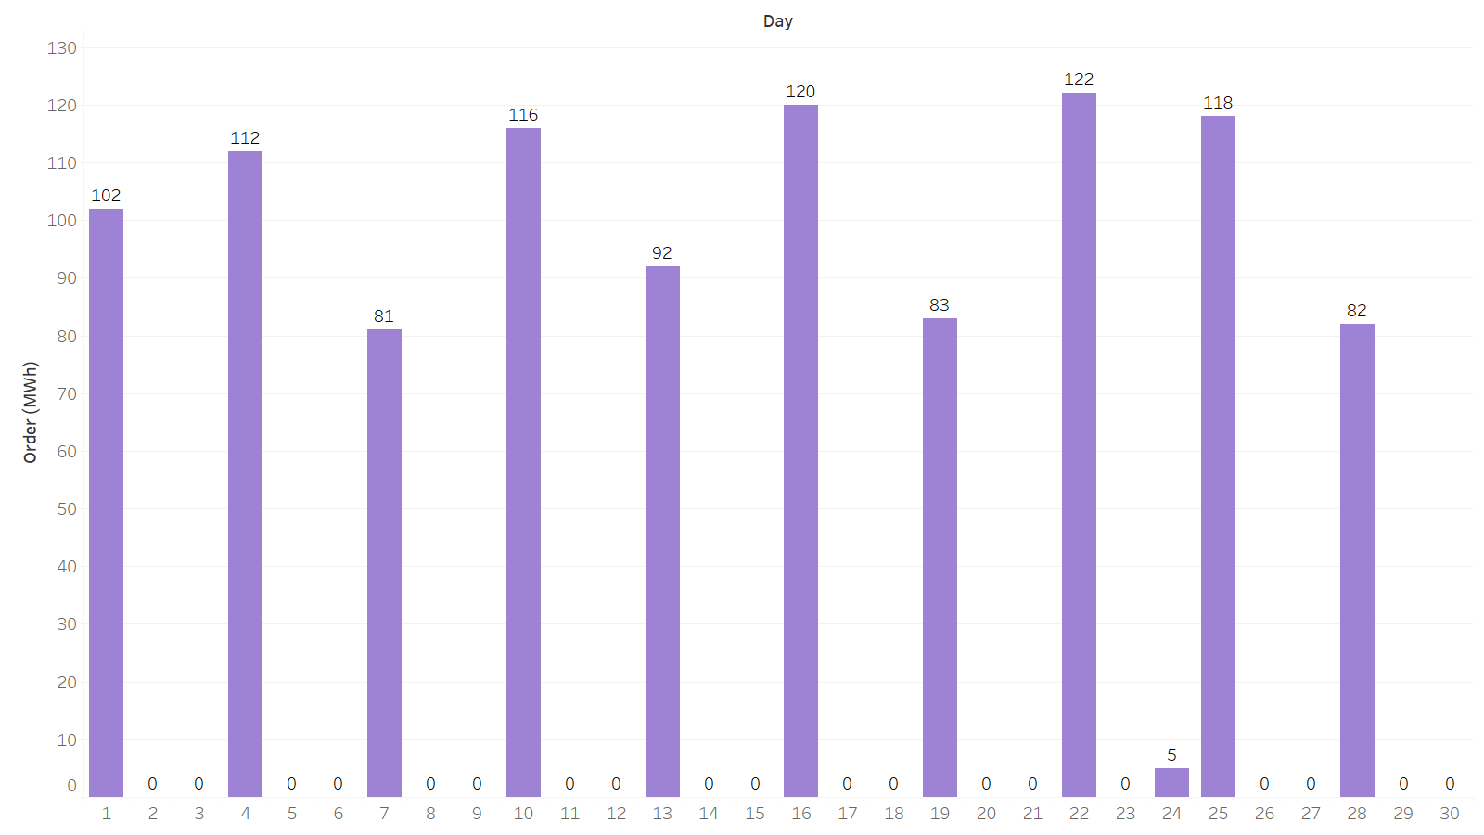
Daily Electricity Order for June
19 days with 0 order

Slide 5
Solution
$55329.57
Expected Total Cost

Slide 6
Communication 14
60%
40%
Normal Demand
High Demand
31, 32, 39, 32, 36, 25, 33, 33, 34, 36, 36, 28, 28, 47, 33, 40, 41, 27, 37, 29, 29, 42, 49, 36, 38, 32, 29, 32, 27, 42
54, 57, 65, 54, 59, 45, 58, 54, 52, 66, 55, 44, 49, 83, 59, 66, 68, 49, 62, 54, 53, 79, 82, 61, 65, 53, 47, 51, 50, 65

Slide 7
Solution
$73593.87
111 MWh
Expected Total Cost
Initial Order

Slide 8
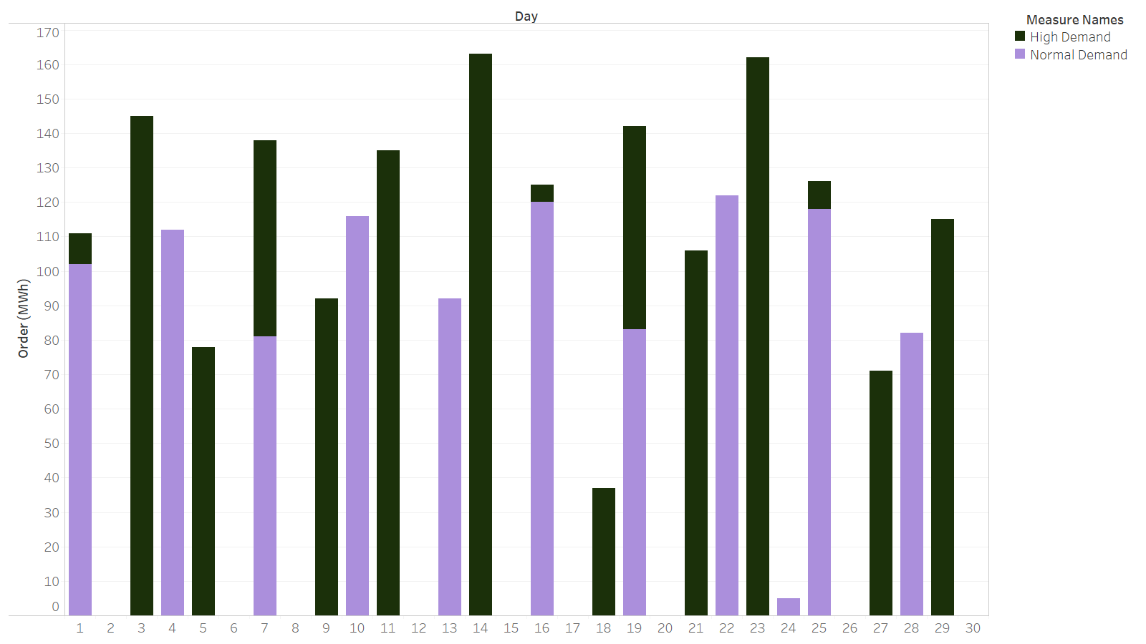
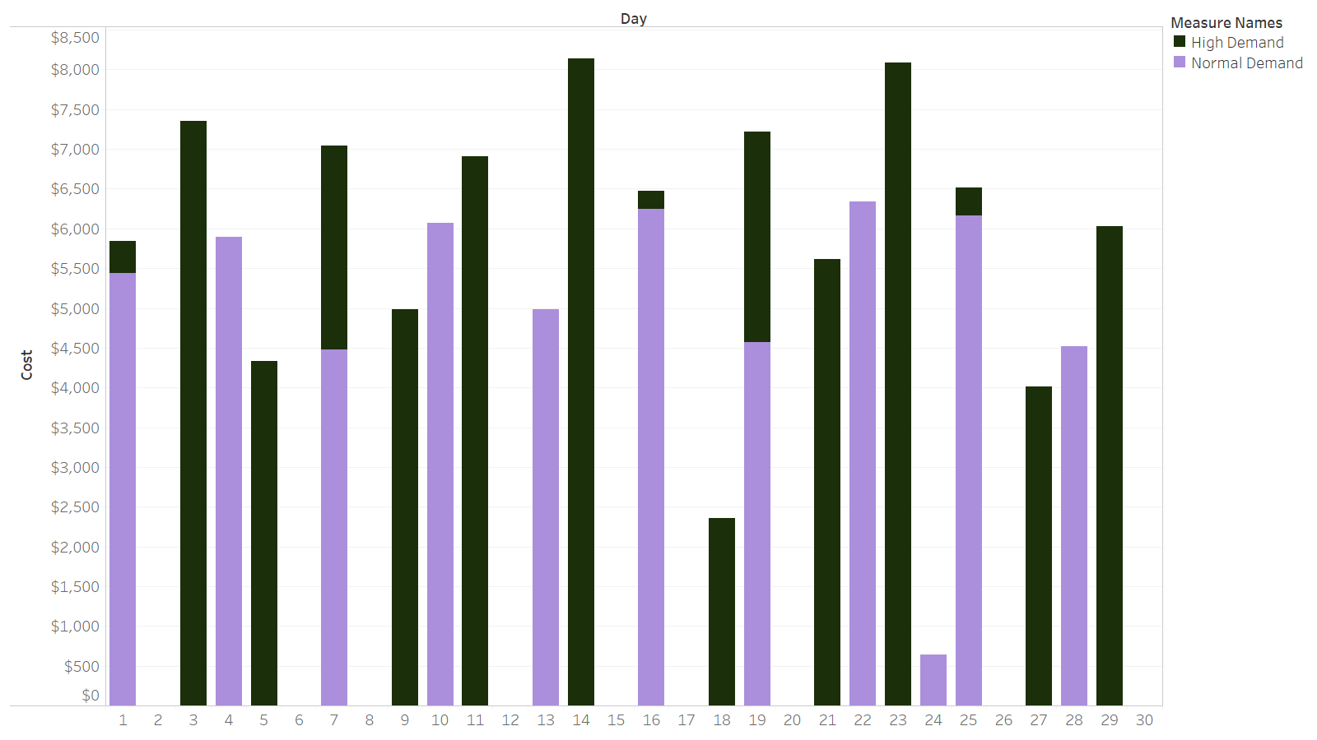
Daily Electricity Order
Daily Cost

Slide 9
Communication 15
Reduce the chance of high demand
10%
5
45K
Chance
Days
90% chance of normal demand

Slide 10
Solution
$70901.46
$2500+
Expected Total Cost
Cost Saving

Slide 11
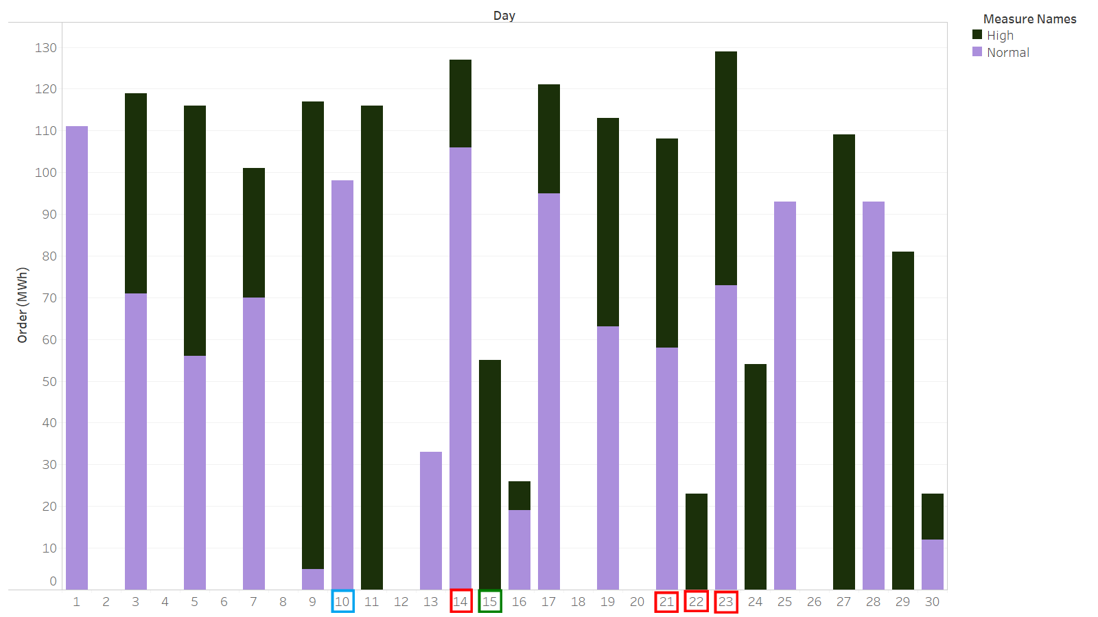
Daily Electricity Order
Reduction days based on surplus electricity storage
Blue: reduction day only for normal demand
Green: reduction day only for high demand
Red: reduction day for both normal & high demand
Note: 5 days for each demand storage in June

Slide 12
Communication 16
If high demand for previous day
High Demand
Normal Demand
50%
50%
If normal demand for previous day
High Demand
Normal Demand
20%
80%
10% high demand chance for 5 days still works,
regardless whether it is high or normal demand the previous day

Slide 13
Solution
$65601.65
$5300
111 MWH
Expected Total Cost
Cost Saving
Initial Order

Slide 14
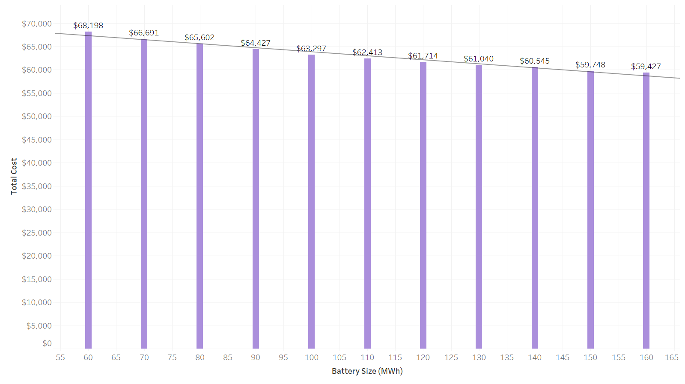
Battery Size vs. Total Cost

Slide 15
Thanks!

